Slide 1
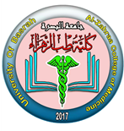

University of Basrah Al-zahraa medical college
Ministry of higher Education
and Scientific Research
The module: Mechanism of Disease
Session 6 / Lectures 1
Haemostasis and Thrombosis (II)
Module staff: Session 6
Dr. Sadiq K. Ali (Module leader)
Dr. Ihsan Mardan
Dr. Iman Abdul-Hadi Dr. Ghada Lateef
Dr. Wasan Mansur
Dr. Safa Asaad
Robbin’s Basic pathology 9th edition
Hoffbrands Essential Haematology 7th edition

Slide 2
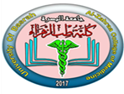
Learning objectives:
Embolism;
  Definition
  Thromboembolism particularly DVT and pulmonary embolism
  Other types of embolism
Anti-coagulant therapy;
  Heparin
  Warfarin
  Prophylaxis in general
Other disorders of coagulation;
  Haemophilia
  Disseminated intravascular coagulation
  Thrombocytopenia
  Thrombophilia

Slide 3
Session 6
Lecture 1
LO:3
3- EMBOLISM
An embolus is a detached intravascular solid, liquid, or gaseous mass that is carried by the blood to a site distant from its point of origin.
Virtually 99% of all emboli represent some part of a dislodged thrombus, hence the term thromboembolism.

Slide 4
LO:3
3- EMBOLISM cont…
Less common types of emboli include
Fat droplets,
Bubbles of air or nitrogen,
Atherosclerotic debris (cholesterol emboli),
Tumor fragments,
Bits of bone marrow, and
Amniotic fluid.

Slide 5
LO:3
Clinical Correlations:
Venous versus Arterial Thrombosis
Many factors contribute to the pathogenesis of venous and arterial thrombosis, including genetic predisposition and acquired risk factors.
Most patients with venous thrombosis, vascular stasis and increased blood coagulability are most important and vessel wall damage is less important than in arterial disease.

Slide 6
LO:3
Clinical Correlations:
Venous versus Arterial Thrombosis
Risk factors for thrombosis

Slide 7
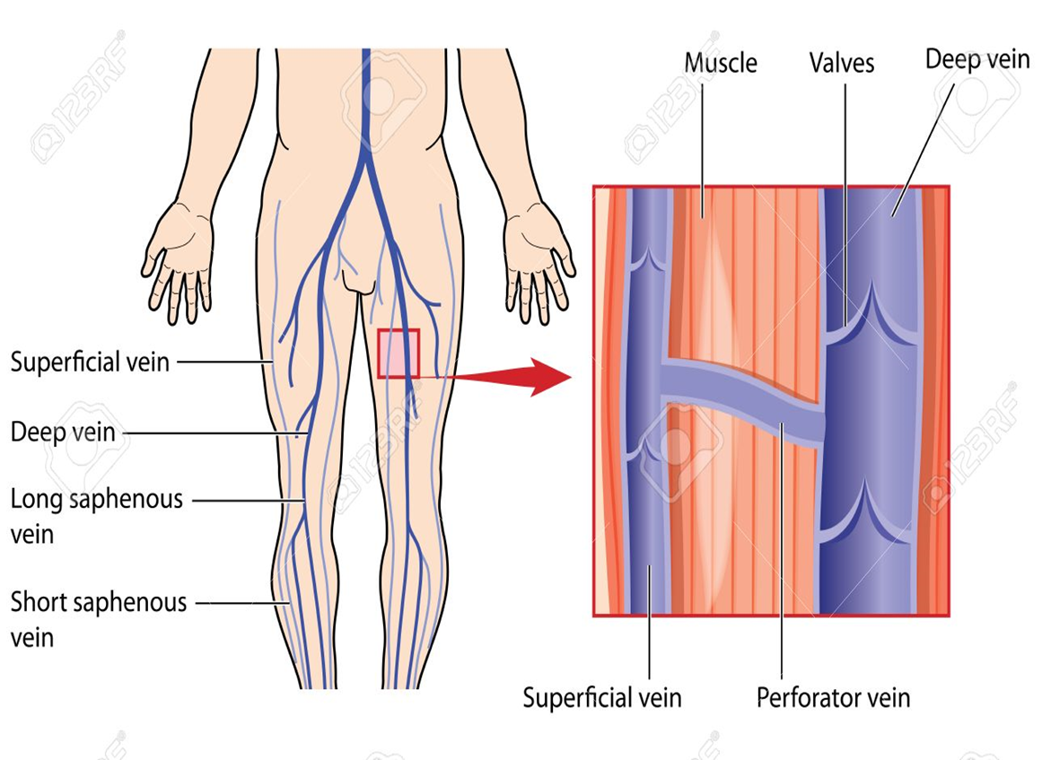
LO:3
Venous Thrombosis (Phlebothrombosis)
Most venous thrombi occur in either the superficial or the deep veins of the leg.

Slide 8
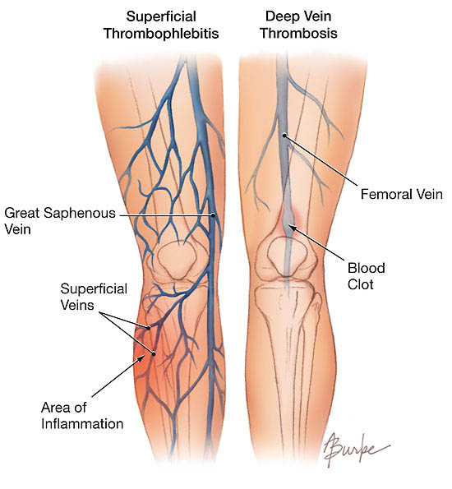
LO:3
Venous Thrombosis (Phlebothrombosis) cont…
Deep venous thromboses (DVTs) in the larger leg veins at or above the knee joint (e.g., popliteal, femoral, and iliac veins) are more serious because they are prone to embolize.
Superficial venous thrombi usually arise in the saphenous system, particularly in the setting of varicosities; these rarely embolize but can be painful and can cause local congestion and swelling from impaired venous outflow, predisposing the overlying skin to development of infections and varicose ulcers.

Slide 9
LO:3
Venous Thrombosis (Phlebothrombosis) cont…
Consequently, DVTs are entirely asymptomatic in approximately 50% of patients and are recognized only after they have embolized.
DVT is suspected in patients with calf swelling or tenderness, unilateral pitting edema, and the presence of collateral superficial nonvaricose veins.
The modified Wells score is used in acute clinical presentations to predict the likelihood of leg DVT. The diagnosis should be confirmed by imaging such as with Doppler ultrasound scan.

Slide 10
LO:3
Venous thromboembolism (VTE), which comprises deep vein thrombosis (DVT) and pulmonary embolism (PE), with two-thirds presenting as DVT and one-third as PE.
Pulmonary embolism has an incidence of 20 to 25 per 100,000 hospitalized patients.
In greater than 95% of PE cases, venous emboli originate from thrombi within deep leg veins proximal to the popliteal fossa; embolization from lower leg thrombi is uncommon.

Slide 11
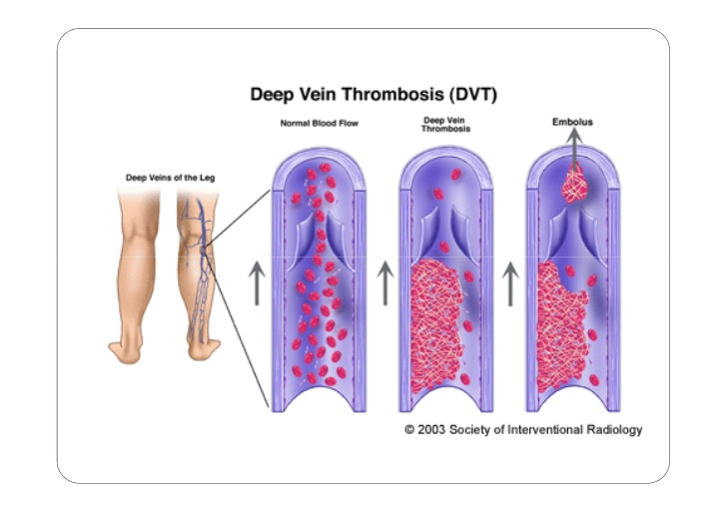
LO:3
Pulmonary Thromboembolism cont…

Slide 12
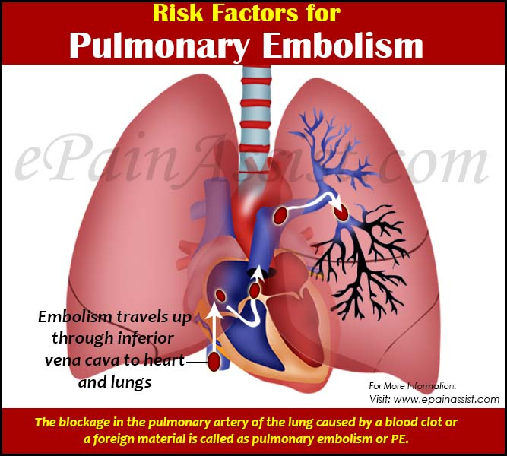

Slide 13
LO:3
Most pulmonary emboli (60% to 80%) are clinically silent because they are small.
Clinical presentation of PE depends on the size, location and number of emboli, and the patient’s underlying cardiorespiratory reserve.
The classic triad of chest pain, haemoptysis and dyspnoea is present in less than 20% of patients, but nearly all will have at least one of pleuritic chest pain, dyspnoea or tachypnoea.

Slide 14
LO:3
A sudden onset of dyspnea is the usual presenting symptom.
Harsh substernal pain is a feature of massive embolism.
Pleuritic chest pain and haemoptysis occur only after infarction has occurred.
A large embolus that blocks a major pulmonary artery can cause sudden death.
Sudden death, right ventricular failure (cor-pulmonale), or cardiovascular collapse occurs when 60% or more of the pulmonary circulation is obstructed with emboli.

Slide 15
LO:3
Systemic Thromboembolism
Systemic thromboembolism refers to emboli in the arterial circulation.
Most (80%) arise from intracardiac mural thrombi, two-thirds of which are associated with left ventricular wall infarcts and another third with dilated left atria (e.g., secondary to mitral valve disease).
The consequences of embolization depend on the caliber of the occluded vessel, the collateral supply, and the affected tissue’s vulnerability to anoxia.

Slide 16
LO:3
Fat Embolism
Microscopic fat globules can be found in the circulation after fractures of long bones (which contain fatty marrow) or after soft-tissue trauma. Fat enters the circulation by rupture of the marrow vascular sinusoids or rupture of venules in injured tissues.
fat embolism syndrome characterized by pulmonary insufficiency, neurologic symptoms, anaemia, thrombocytopenia, and a diffuse petechial rash, which is fatal in 10% of cases.

Slide 17
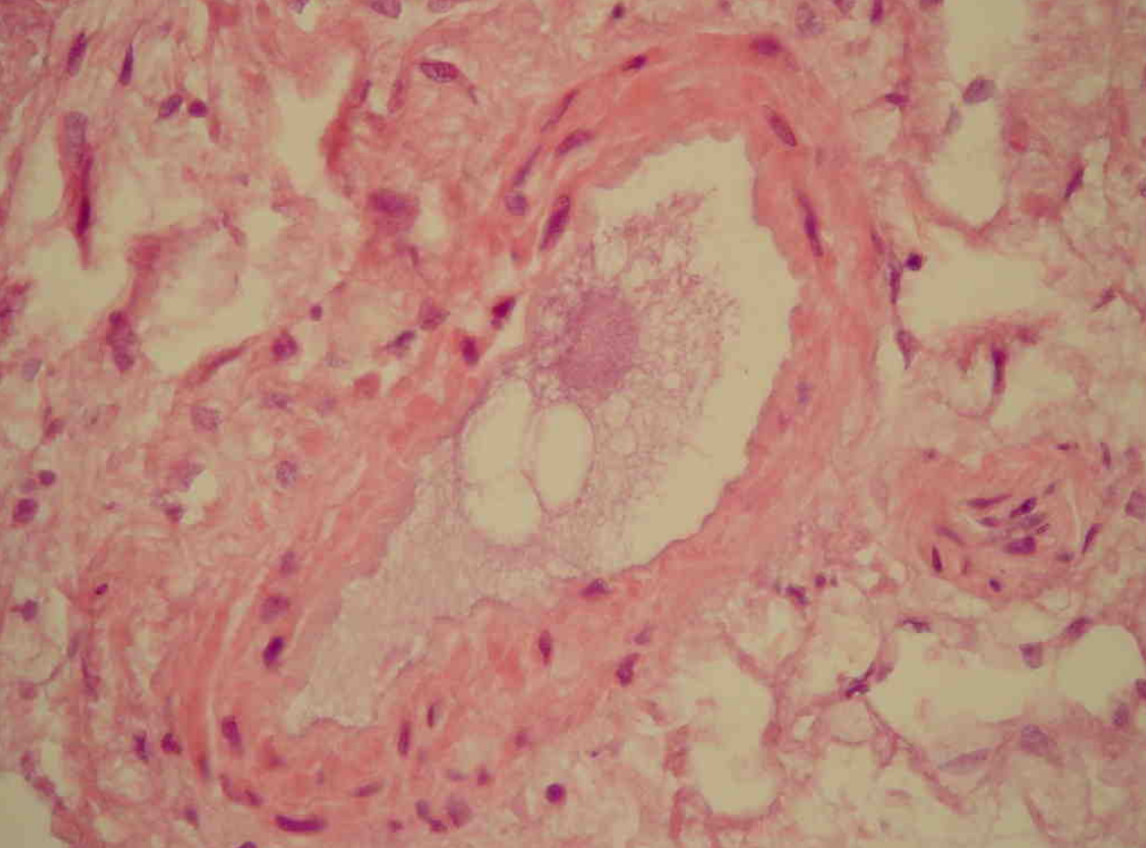
LO:3
Fat Embolism

Slide 18
LO:3
Amniotic Fluid Embolism
Amniotic fluid embolism is an uncommon, grave complication of labour and the immediate postpartum period (1 in 40,000 deliveries).
The mortality rate approaches 80%, making it the most common cause of maternal death in the developed world.
The underlying cause is entry of amniotic fluid (and its contents) into the maternal circulation via tears in the placental membranes and/or uterine vein rupture.

Slide 19
LO:3
Air Embolism
Gas bubbles within the circulation can obstruct vascular flow (and cause distal ischemic injury) almost as readily as thrombotic masses can.
Air may enter the circulation during obstetric procedures or as a consequence of chest wall injury. Generally, more than 100 mL of air are required to produce a clinical effect; bubbles can coalesce to form frothy masses sufficiently large to occlude major vessels.

Slide 20
LO:3
Air Embolism cont…
Decompression sickness describes a condition arising from dissolved gases coming out of solution into bubbles inside the body on depressurisation, caisson disease in which recurrent or persistent gas emboli in the bones lead to multifocal ischemic necrosis.

Slide 21


